Slide 1
Agenda
Introduction
Objective of the Tool
Attack Vector, Attack Surface & Attack Arena
System Architecture
Working of the ShieldGuard Tool
Tools Used
Proof of Concept (PoC)
Impact Analysis
Mitigation & Blocking Mechanism
Conclusion
References

Slide 2
Abstract
This project presents ShieldGuard, a web-based DoS/DDoS detection tool designed to monitor network traffic and identify abnormal traffic spikes in real time. The system captures packet-level data and analyzes traffic patterns to detect potential denial-of-service attacks. Although the proof of concept is implemented in a controlled localhost environment, the tool is not limited to local testing and can be deployed on external servers, cloud instances, or network gateways by configuring the appropriate network interface and IP settings. Upon detection, the system identifies the attacking source, applies blocking rules, and provides real-time visualization through an intuitive web dashboard, making it suitable for flexible deployment across different network environments.

Slide 3
Introduction
Denial of Service (DoS) and Distributed Denial of Service (DDoS) attacks are among the most common and disruptive cyber threats targeting modern networks and web services. These attacks aim to overwhelm servers or network resources with excessive traffic, leading to service downtime, performance degradation, and financial and reputational losses. With the increasing dependency on online services, early detection and rapid mitigation of such attacks have become critical.
This project introduces ShieldGuard, a DoS/DDoS detection tool designed to continuously monitor network traffic, analyze traffic behavior, and identify abnormal spikes that indicate potential attacks. The system provides real-time visibility into network activity through a simple and intuitive web-based interface. By detecting malicious traffic patterns and responding promptly, the tool helps improve network resilience and ensures service availability across local and deployed server environments.

Slide 4
Attack Vector , Attack Surface, Attack Arena
Attack Vector
Attack vectors refer to the methods used by attackers to launch DoS or DDoS attacks against a system. In the context of ShieldGuard, common attack vectors include TCP SYN floods, ICMP floods, UDP floods, and HTTP request floods. These attacks exploit network and transport layer protocols by sending excessive or malformed traffic to exhaust server resources and disrupt normal service availability.
Attack Surface
The attack surface represents all possible entry points where an attacker can target the system. For ShieldGuard, the attack surface includes network-facing services such as open ports, web servers, exposed APIs, and the network interface itself. Any service that accepts incoming network traffic can become a potential target for DoS or DDoS attacks if not properly monitored and protected.
Attack Arena
The threat arena defines the environment in which attacks can occur. ShieldGuard considers multiple threat arenas, including local systems, on-premise servers, and cloud-based deployments. Attacks may originate from a single system in a local network or from multiple distributed sources across the internet. The tool is designed to operate across these environments by monitoring traffic behavior and adapting detection mechanisms based on the deployment context.

Slide 5
System Architecture
ShieldGuard is built using a layered architecture that enables real-time monitoring, detection, and mitigation of DoS and DDoS attacks. Network traffic is continuously captured from the selected interface using Scapy, allowing low-level packet inspection without impacting normal network operations. The captured packets are processed by the traffic analysis module, where Python-based logic computes metrics such as packet count, traffic rate, and abnormal spikes within defined time windows.
These metrics are evaluated by the detection engine, which applies threshold-based rules to identify potential DoS or DDoS attacks. When an attack is detected, the mitigation module uses iptables to block the malicious source IP address at the firewall level, reducing further impact on the system. All detection results, packet statistics, and mitigation actions are communicated to a web-based dashboard developed using Flask, which provides real-time visualization of traffic spikes, attack status, and blocked IP information. The architecture supports deployment on localhost as well as external servers by configuring the appropriate network interface and security rules.

Slide 6
Working of the ShieldGuard Tool
The ShieldGuard tool is launched and initializes all required modules, including packet capture, analysis, detection, and the web interface.
Once activated, the system continuously receives network traffic from the configured network interface.
Incoming packets are processed within predefined time windows to observe traffic behavior and request patterns.
The system establishes a baseline of normal activity and compares current traffic against this behavior.
When abnormal activity is observed, the detection engine evaluates it against predefined rules to determine whether it represents a DoS or DDoS attack.
Upon confirming an attack, the tool identifies the source IP address responsible for the abnormal traffic.
The mitigation module applies firewall rules to block the malicious IP and reduce further impact on the system.
All actions, including detection results and mitigation status, are reflected in real time on the web-based dashboard.

Slide 7
Start Linux System
Activate ShieldGuard Environment
Launch ShieldGuard Tool
Receive Network Traffic
Analyze Traffic Behavior
Detect DoS / DDoS Attack
Identify Attacker IP
Block Malicious IP
Update on Web Dashboard
Continue Monitoring

Slide 8
Tools used
Kali Linux – Operating system used for development, testing, and security analysis
Python – Core programming language used to implement detection logic and automation
Scapy – Used for packet capturing and low-level network traffic analysis
Flask – Used to develop the web-based dashboard and user interface
iptables – Used to block malicious IP addresses at the firewall level
hping3 – Used to simulate DoS and DDoS attacks in a controlled environment
Wireshark – Used to observe and verify network traffic during normal and attack conditions

Slide 9
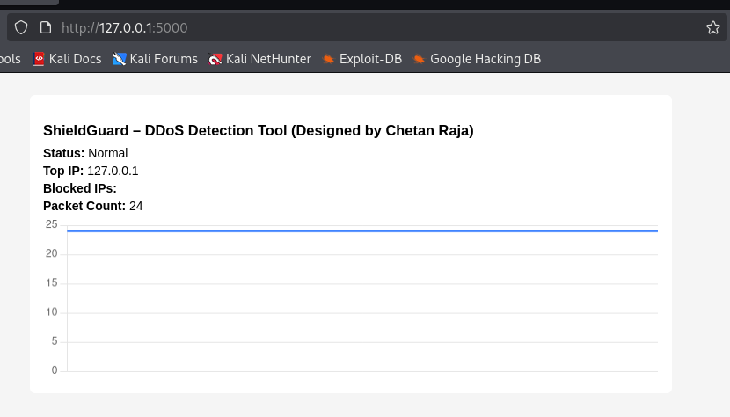

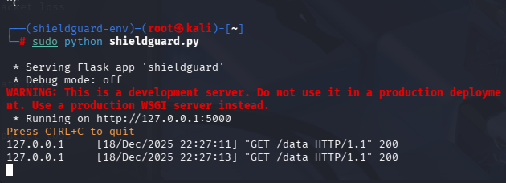
Proof of Concept (PoC)
Monitor on Website
Go to the Environment
Run the file with Python code

Slide 10
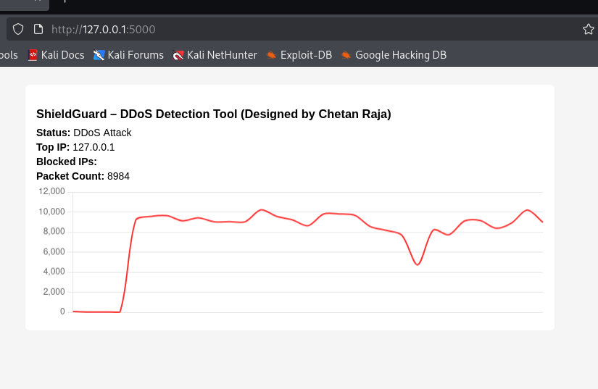
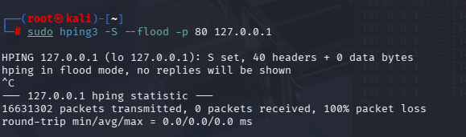
Proof of Concept (PoC)
Monitor on Website
Start the Attack

Slide 11
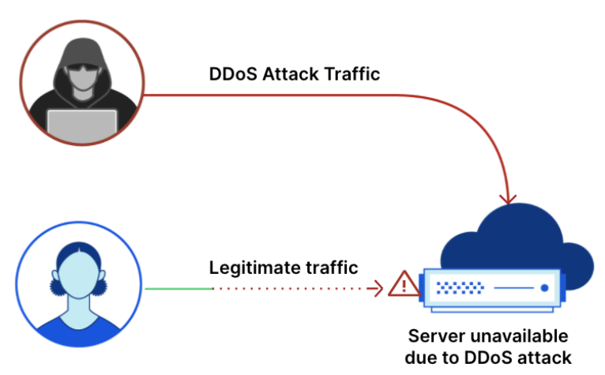

Impact Analysis
DoS and DDoS attacks can cause service unavailability and application downtime.
High traffic floods may exhaust server resources such as bandwidth, CPU, and memory.
Legitimate users may experience slow response times or complete denial of access.
Repeated attacks can lead to financial loss and damage to organizational reputation.
Effective detection and mitigation reduce operational risk and improve service reliability.

Slide 12

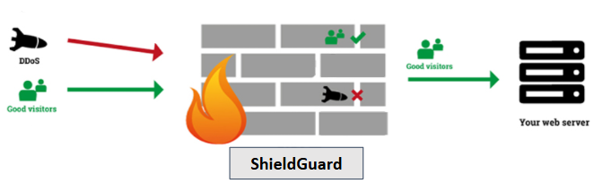
Mitigation & Blocking Mechanism
ShieldGuard identifies the source IP responsible for malicious activity.
Firewall rules are applied to block the detected attacker IP.
Blocking prevents further malicious traffic from reaching the server.
The system updates the attack status and blocked IP details in real time.
This mechanism helps maintain service availability during attack conditions.

Slide 13
Conclusion
ShieldGuard provides an effective solution for detecting and mitigating DoS and DDoS attacks in real time.
The tool successfully identifies abnormal network behavior and malicious sources.
Automated blocking reduces the impact of attacks and helps maintain service availability.
The web-based dashboard improves visibility and simplifies monitoring.
ShieldGuard can be deployed on local systems as well as external servers, making it a flexible security solution.

Slide 14
References
Cloudflare: What is a DDoS Attack?
OWASP Foundation: Denial of Service Cheat Sheet
Kali Linux Documentation
Scapy Official Documentation
Flask Official Documentation
Linux iptables Manual
Wireshark User Guide

Slide 15
Thank You!

